Slide 1
Is Free Trade Out of Date?

Slide 2
Agenda
Trade simulation
Framing the issue (p308)
Why trade?
Trade theory
Trade agreements
Trade-related issues around the world

Slide 3
Why Trade?
Allows specialization in what a nation is best at:
climate
human capital
physical capital
resources
technology
property rights
politics and laws
Benefits both parties
Expands choice
Lowers costs/prices
Notes:
https://blog.kaspersky.com/amazing-internet-maps/10441/
“The World Wide Web is probably the most widespread project created in the history of humanity. With each passing year, the Internet grows exponentially. It needs cables, servers, towers and a lot of other things to work; this complicated infrastructure is being constantly updated and upgraded.”

Slide 4
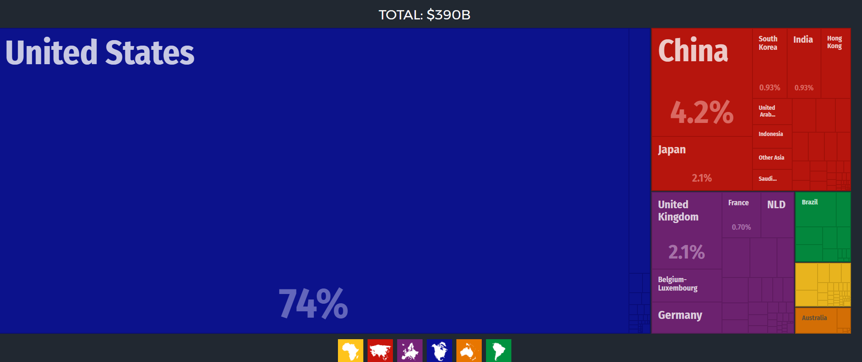
2015 Canadian Exports
Energy Products (17%)
Motor Vehicles and parts (16%)
Metals and Minerals (12%)
Consumer Goods (12%)s (12%)
Notes:
http://atlas.media.mit.edu/en/profile/country/can/#Exports

Slide 5
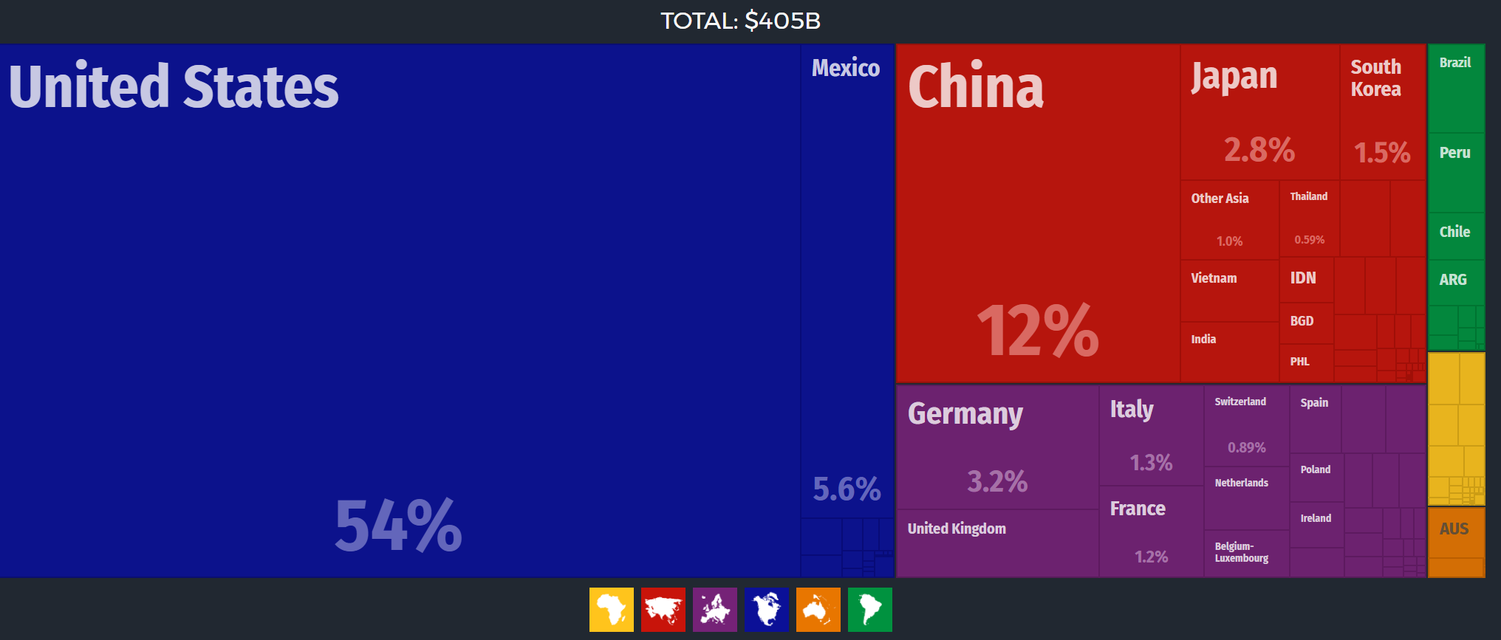
2015 Canadian Imports
68% came from USA
9% came from EU
Consumer Goods (21%)
Motor Vehicles and Parts (19%)
Electrical and Electronic Parts (13%)
Industrial Machinery (11%)
Notes:
http://atlas.media.mit.edu/en/profile/country/can/#Exports

Slide 6
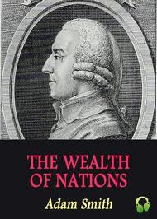
Adam Smith on Trade
From An Inquiry in the Nature and Causes of the Wealth of Nations (1776)
“It is a maxim of every prudent master of a family, never to attempt to make at home what will cost him more to make than to buy. The tailor does not attempt to make his own shoes, but buys them of the shoemaker. The shoemaker does not attempt to make his own clothes but employs a tailor.”

Slide 7
The Theory of Absolute and Comparative Advantage
Absolute Advantage: The comparison among producers of a good according to their productivity.
Who can produce using less resources?
Comparative Advantage: The comparison among producers of a good according to their opportunity cost.
Who can produce with a lower opportunity cost?

Slide 8
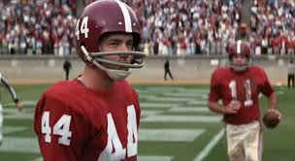
A Lesson for Fresh Minds of All Ages
Even if you’re the best:
Football player player
Shrimp boat captainr
Soldierplayer
Can you do them all (at once)?

Slide 9
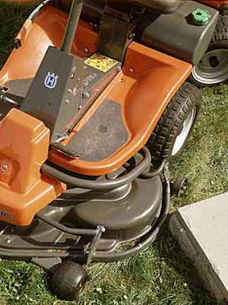
Sidney Crosby Example
Sidney Crosby is a great hockey player and a great lawn mower.
Crosby can mow his lawn in 2 hours
What is his opportunity cost??
Little Neighbour Tawnalini can mow Crosby’s lawn in 4 hours
What is her opportunity cost?

Slide 10
Sidney Crosby Example
Who has the absolute advantage in mowing grass?
Who has the comparative advantage in mowing grass?
Who should mow Crosby’s lawn?

Slide 11
Regional Trade Arrangements
Negotiations concluded on TPP, EU and Ukraine
Korea: January 1, 2015
Honduras: October 1, 2014
Panama: April 1, 2013
Jordan: October 1, 2012
Columbia: August 15, 2011
Peru: August 1, 2009
European Union: July 1, 2009
Costa Rica: November 1, 2002
Chile: July 5, 1997
Israel: January 1, 1997
NAFTA: January 1, 1994
Notes:
https://www.wto.org/english/tratop_e/region_e/regfac_e.htm

Slide 12
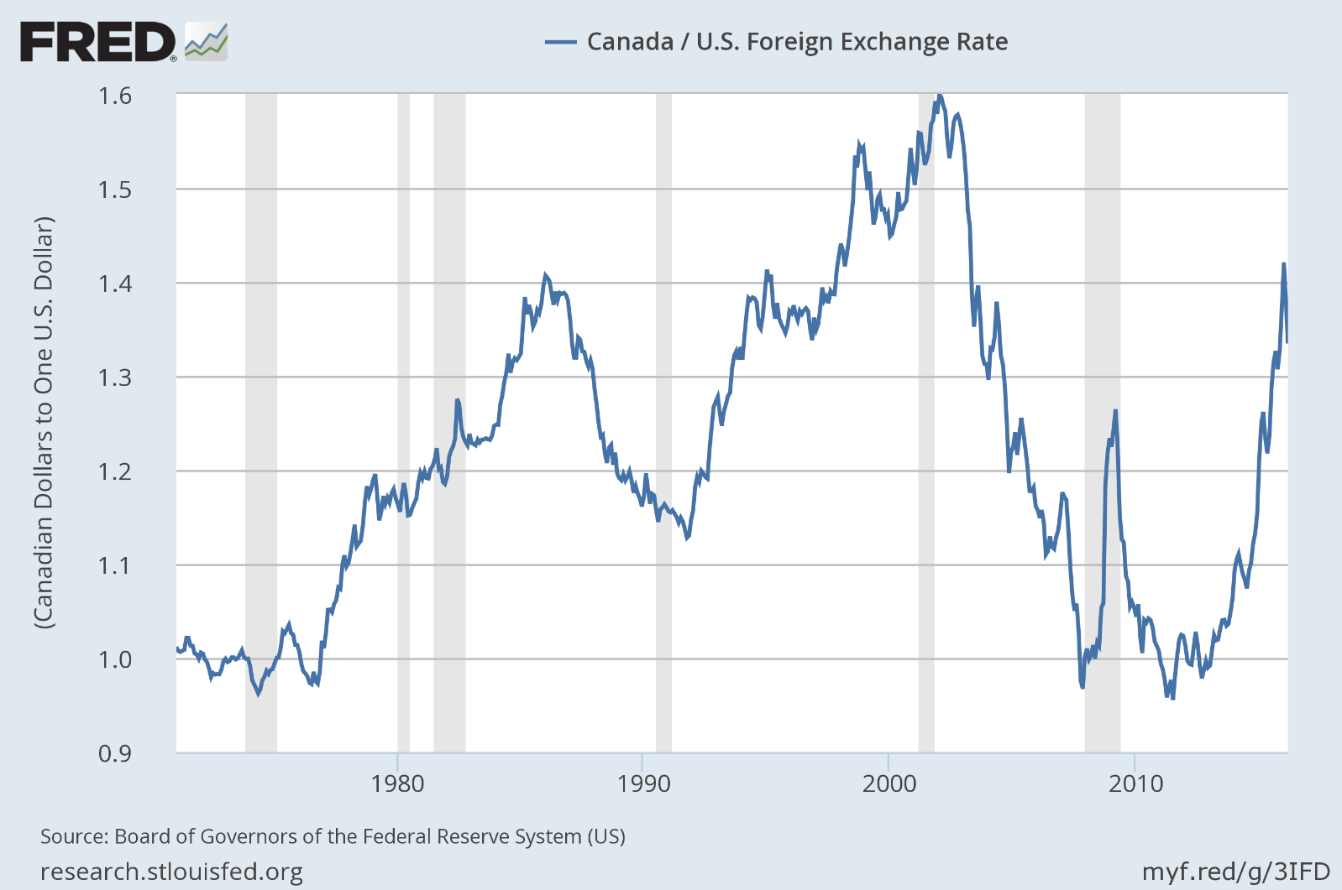
Current Issue: Weaker C$/Stronger US$

Slide 13
Moving up and out of the shadow of the U.S.!
Notes:
http://atlas.media.mit.edu/en/profile/country/can/#Exports

Slide 14
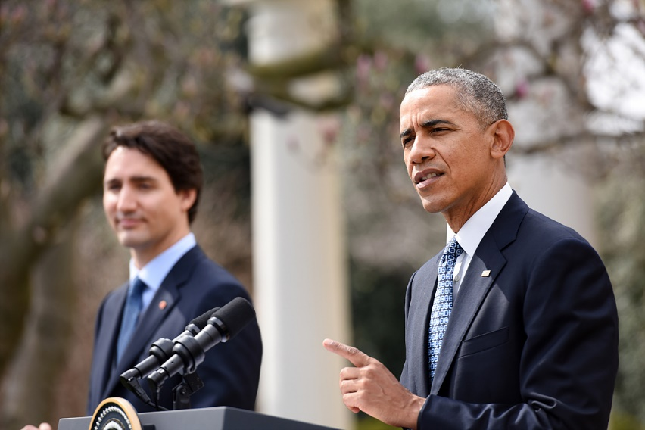
“Arguments for free trade are overwhelming…”
Real income per capita is up
Product differentiation is historically high
Costs are relatively low; prices, too
Net employment is up
Really, what is not to love??? ☺
Prime Minister Justin Trudeau and President Obama move to increase free trade zones around the globe.
Notes:
Economist.com Arguments for Free Trade.

Slide 15
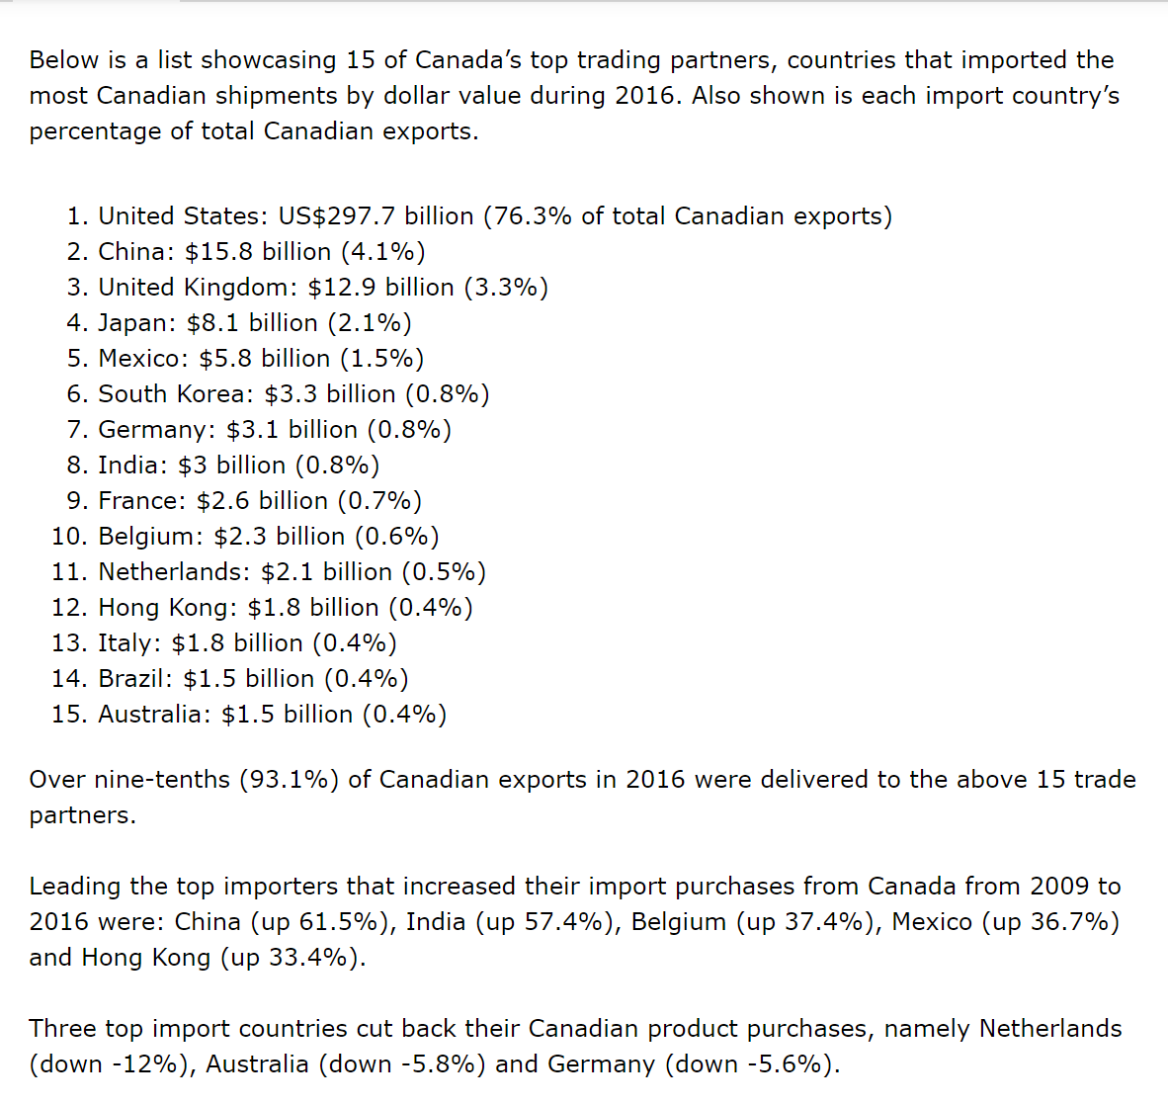
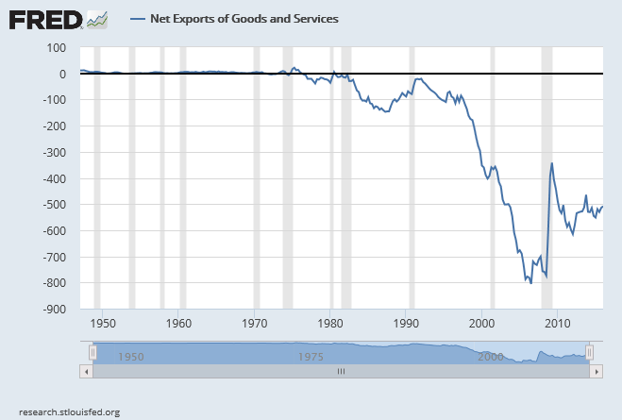
On Trade Deficits and Surpluses
Notes:
http://atlas.media.mit.edu/en/profile/country/can/#Exports

Slide 16
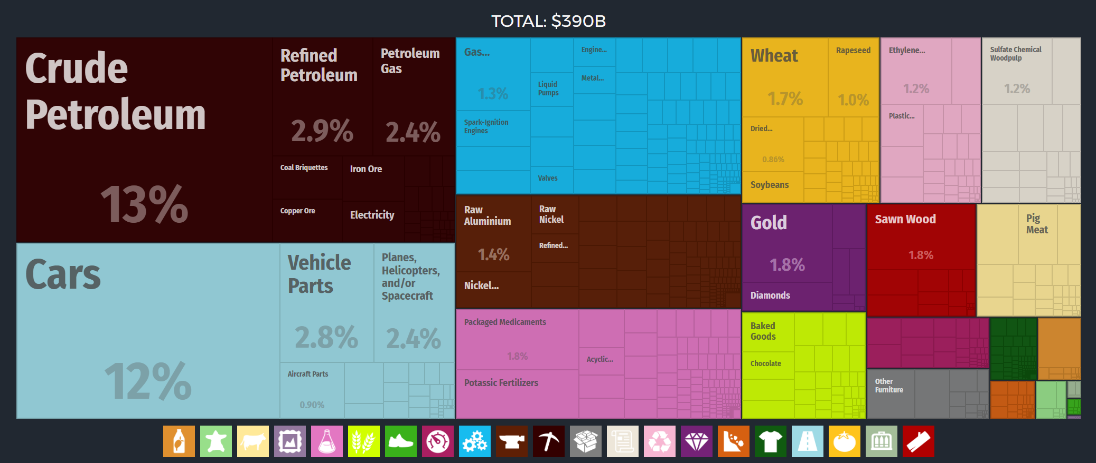
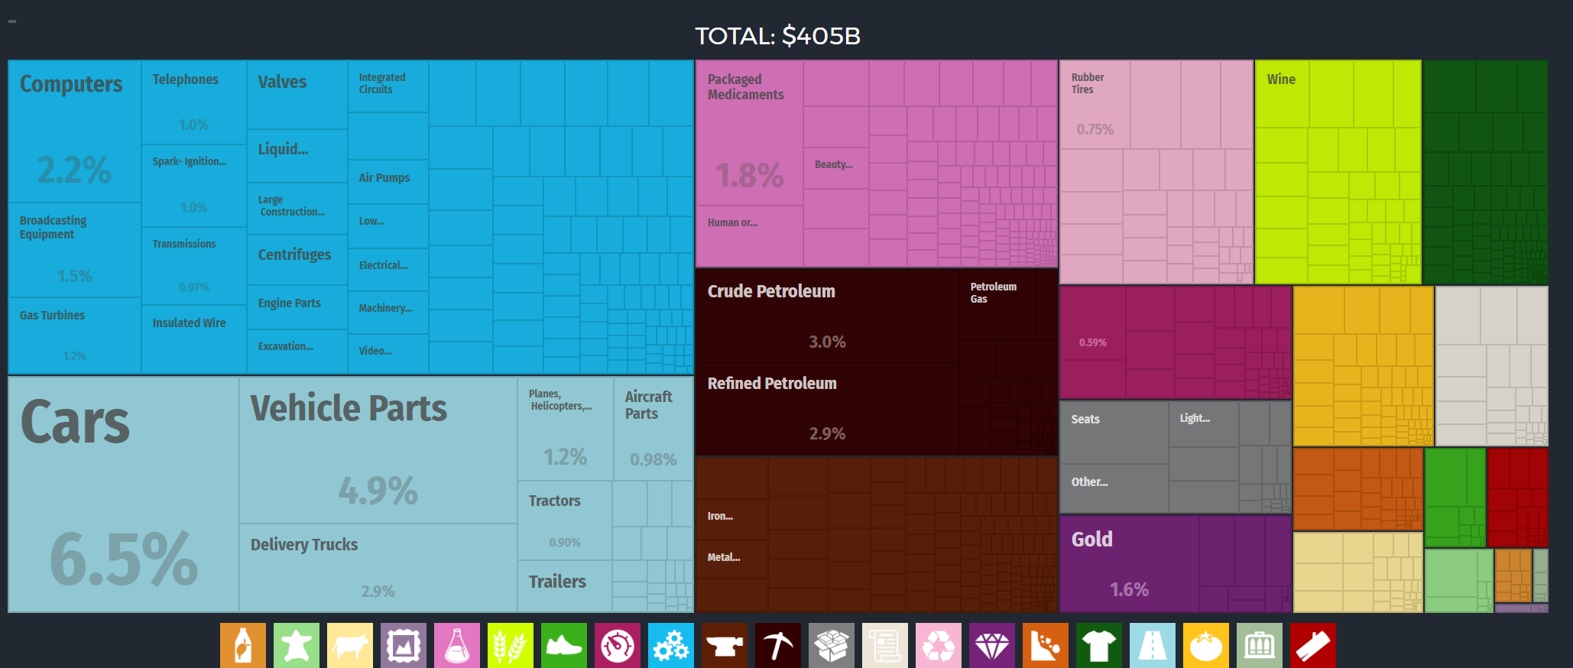
Exciting times!
Notes:
Exports
In 2015 Canada exported $389B, making it the 11th largest exporter in the world. During the last five years the exports of Canada have increased at an annualized rate of 0.5%, from $372B in 2010 to $389B in 2015. The most recent exports are led by Crude Petroleum which represent 12.9% of the total exports of Canada, followed by Cars, which account for 11.5%.

Slide 17
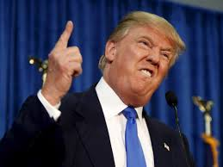
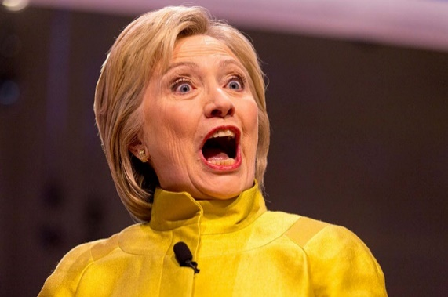
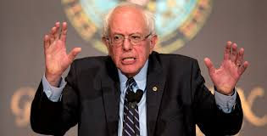
Noisy neighbors to the South are voicing some shared concerns! The Economist reports:
Recent study: 20% of manufacturing job losses since 1999 from Chinese competition in the U.S.
Trade (and automation) increase labor efficiency drastically, but not necessarily creates additional jobs in existing sectors in the U.S.
Can impose big costs on a few places in the U.S.
May explain populist arguments against trade and manufacturing.
But, but, but!!! Look at the unseen!

Slide 18
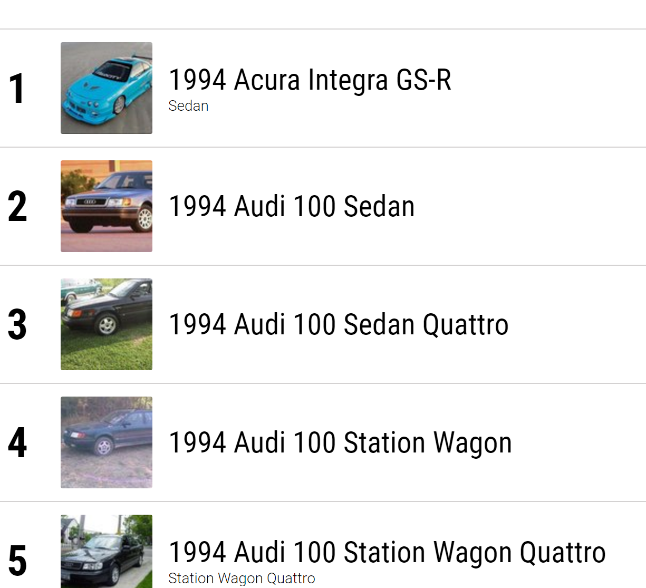
Really, what is there not to love?

Slide 19
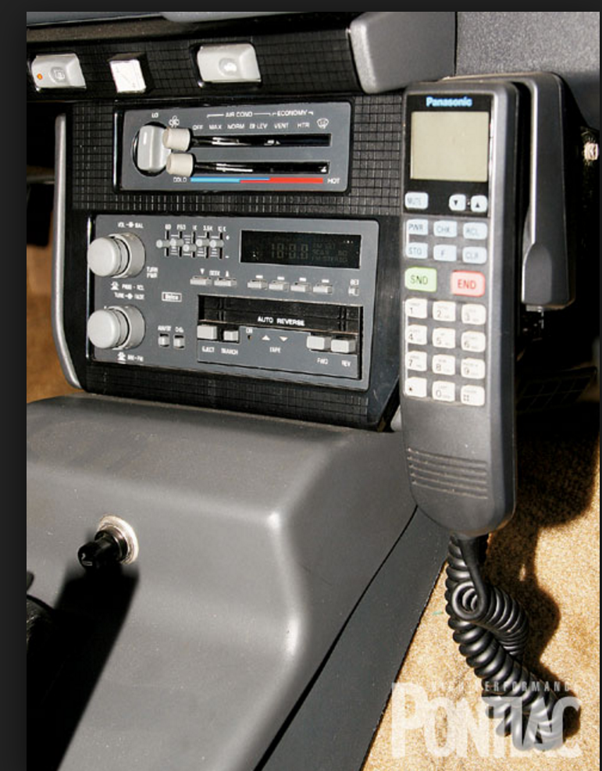
Dig deep into your economics hat. What can you pull out?
Where have some the “freed” resources gone?
Look at the “media” center of the 1994 car…
What is seen and not seen?
Notes:
What do you see? Radio, phone, no navigation, cigarette lighter, other

Slide 20
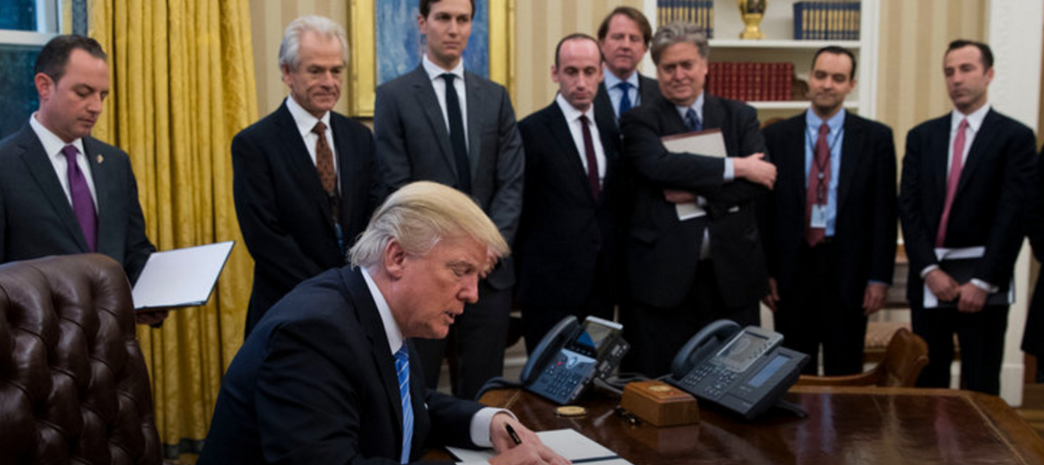
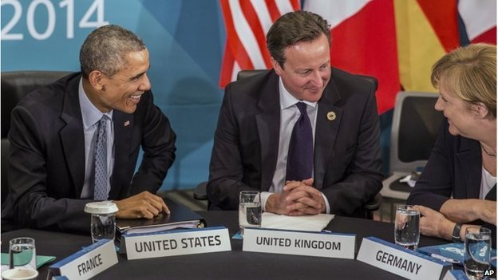
Current Issue 1: TP Trade Struggles in the USA
12 nation Transpacific Partnership
Would have been the largest in world covering 40-46% of world GDP
Tariffs eliminated and regulations standardized
Transpacific Trade and Investment Partnership
President Obama received “fast track” or “trade promotion” authority from Congress
Japan - the only country to have already ratified the pact - Malaysia, Vietnam, Singapore, Brunei, Australia, New Zealand, Canada, Mexico, Chile and Peru.
January 23, 2017
Notes:
http://www.bbc.com/news/business-32498715

Slide 21
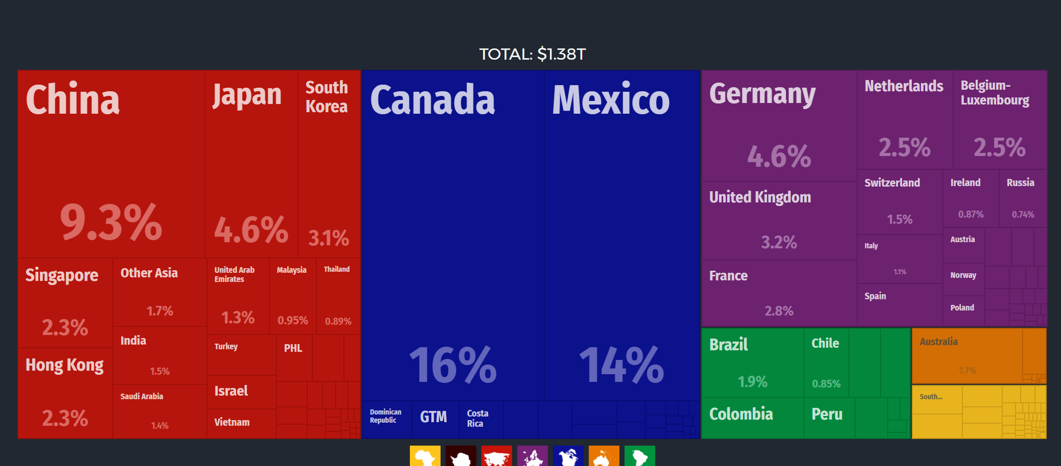
Current Issue 2: NAFTA US exports top “customers”…
Notes:
The top export destinations of the United States are Canada ($219B), Mexico ($188B), China ($128B), Japan ($63.5B) and Germany($63.3B).

Slide 22
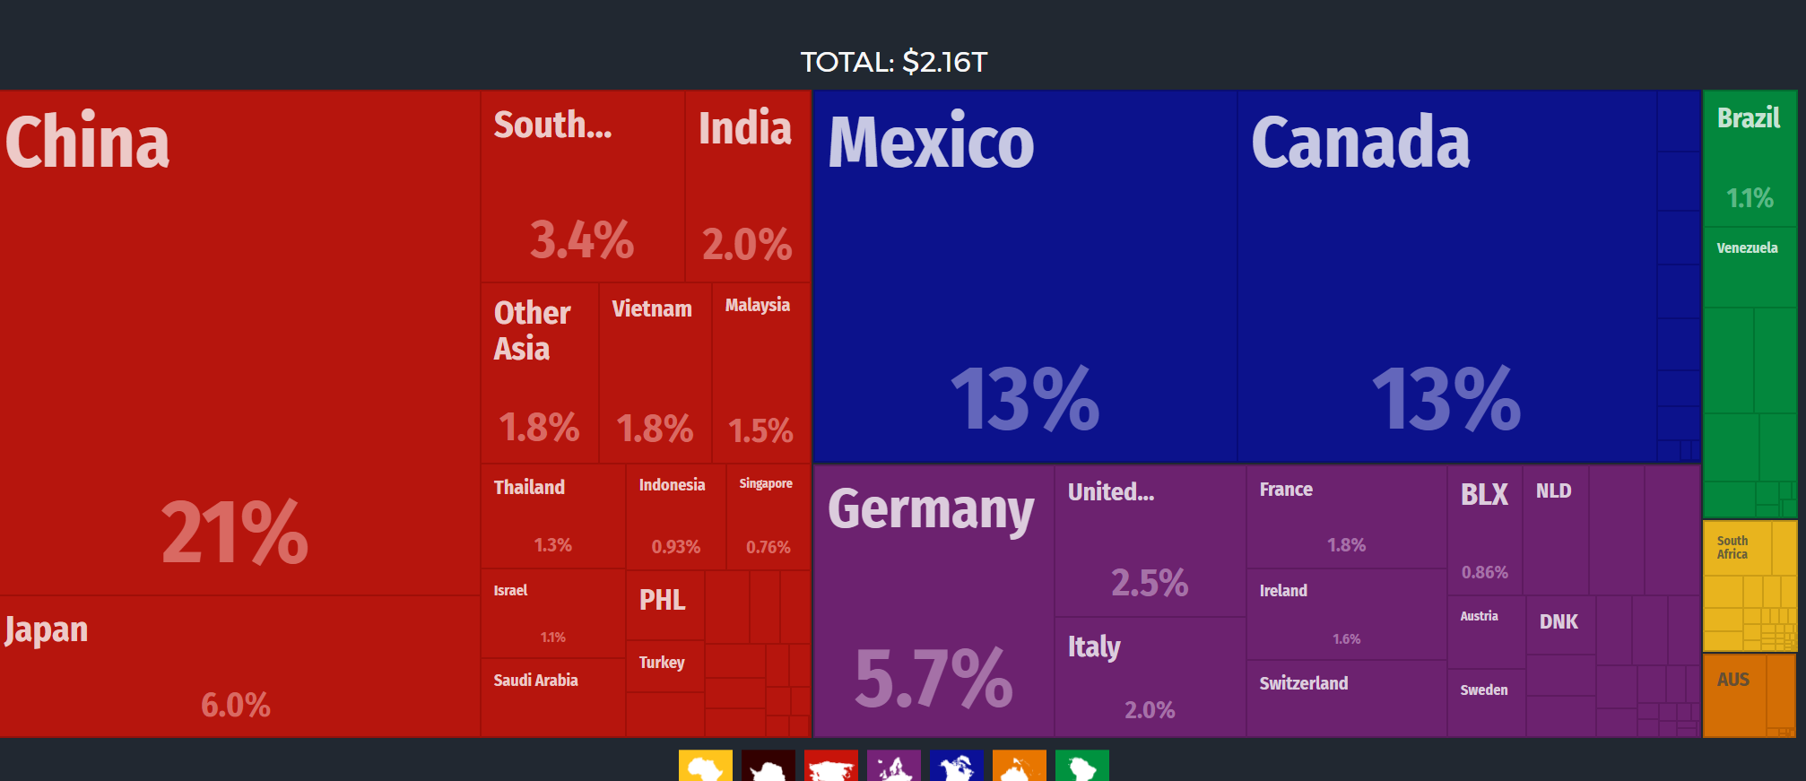
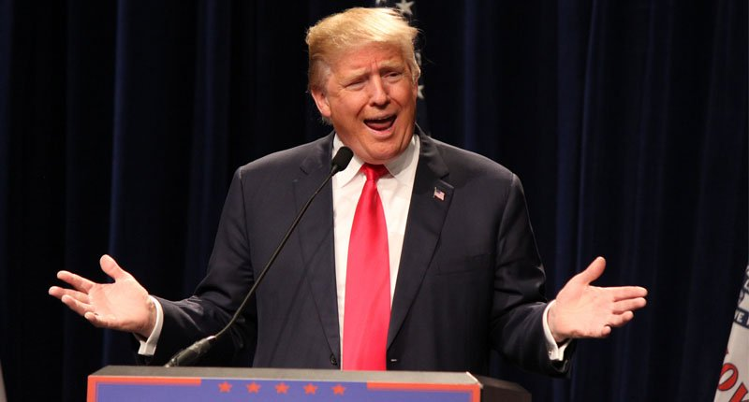
US imports from
Pros
Pros
Cons
Pros
Notes:
http://atlas.media.mit.edu/en/profile/country/usa/
“Origins
The top import origins of the United States are China ($457B), Mexico($291B), Canada ($288B), Japan($128B) and Germany ($122B).”

Slide 23
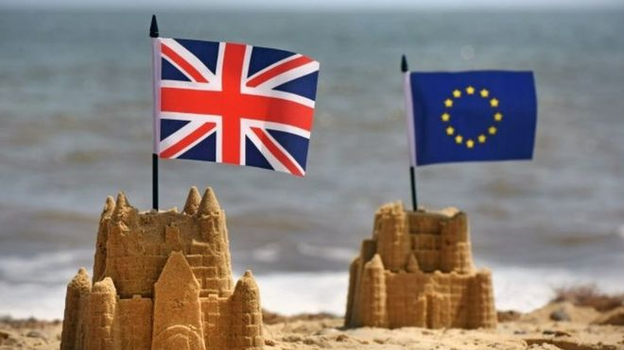
Current Issue 3: Brexit
U.K. is slated to leave EU.
Vote to leave won by 51.9% to 48.1%.
Starting 29 March 2017
UK re-negotiated EU membership:
Maintain access to European Market
Allow country parliaments to block EU legislation
Restrict access to benefits for immigrants for some time period**
New Prime Minister, Theresa May
Notes:
http://www.bbc.com/news/uk-politics-32810887

Slide 24
Questions?

