Slide 1
"Why Do Some Nations Prosper: North and South Korea"
TAWNI HUNT FERRARINI, PhD Robert W. Plaster Professor of Economic Education Lindenwood University, St. Charles, MO 63303 Tawni.org

Slide 2
Overview
Main objective – explain why some nations prosper while others do not
Explain why this topic is important – media reports on N. Korea vs. S. Korea; socialism vs free markets (capitalism)
Describe the methodology behind investigating the topic – (i) inquiry-based learning and (ii) sound economic reasoning
Provide suggestions on how to use the topics covered during this webinar -
Help others understand what economics is and how to use it
Assist individuals interested in learning how to use economic reasoning to explain current events
Assist professionals charged with helping people take current events as reported by the media with consideration for diverse perspectives
Evaluate the differences between the performances of individuals in economies led by heavy-handed governments versus those guided by empowered individuals

Slide 3
Main objective
Explain why rules and regulations defined by government matters.
Command economy – heavy handed government designs policies that allocate resources for consumption, savings, production, and investment purposes. Agencies are monitor successes and failures.
Market economy – empowered individuals allocate their resources to help others consume, save, produce, and invest. Individuals, not agencies, are held responsible and accountable for successes and failures.

Slide 4
Inquiry-based presentation
(1) Interaction
(2) Clarification
(3) Questioning
(4) Design

Slide 5
Interaction
What does the media say? How do media correspondents describe the differences?
Internet search
North Korea | South Korea

Slide 6
Clarification
What are the facts?
North Korea CIA Fact Book | South Korea CIA Fact Book

Slide 7
Questioning based on economic reasoning
People choose when they live in a world of scarcity – time, talent, and treasure.
Every decision has a cost, especially an opportunity cost.
People respond to incentives in predictable ways.
Voluntary trade creates wealth.
Institutions matter.
Today’s decisions have future consequences.

Slide 8
Clarification
https://www.fpri.org/article/2017/04/nations-prosper-case-north-south-korea/

Slide 9
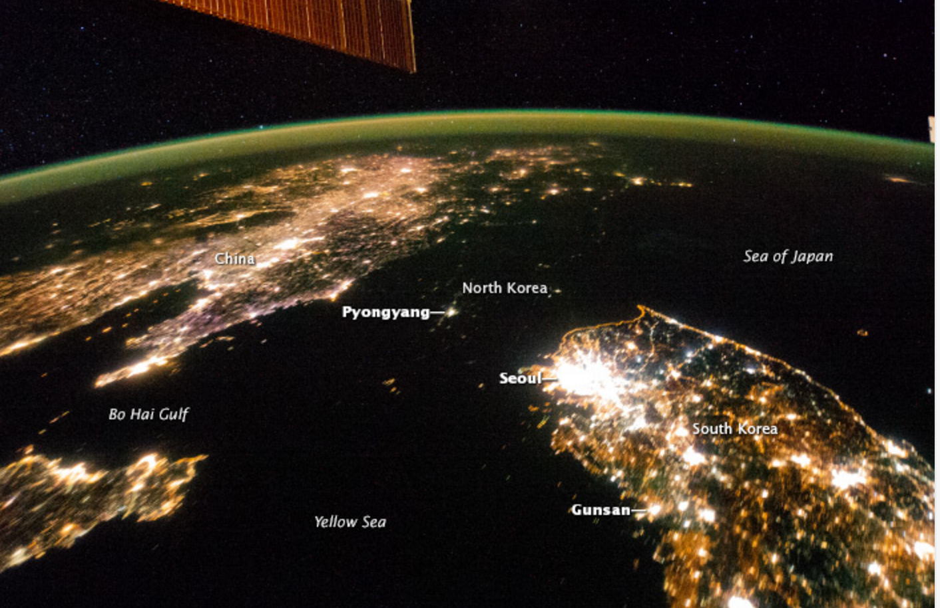
Institutions matter.
Compelling question: What explains the differences among nations in long-term economic growth in North Korea and South Korea when they have a shared history and culture?

Slide 10
Institutions matter.
Economic systems matter.
What explains the differences among nations in long-term economic growth in North Korea and South Korea when they have a shared history and culture?
North Korea relies on a command and control system while South Korea increasingly leans on a free market system to guide resource allocation.

Slide 11
The institutional story
Shared beginnings and separation
Different institutional trajectories
Hermit Kingdom
Japanese occupation
One peninsula: two Koreas
Park ended the very experiment with democracy.
Land reform (started with US assistance and under Rhee.)
Education initiative(started with US assistance and under Rhee.)
Investment in physical and human capital continues.
Export-led growth (managed through chaebol).

Slide 12
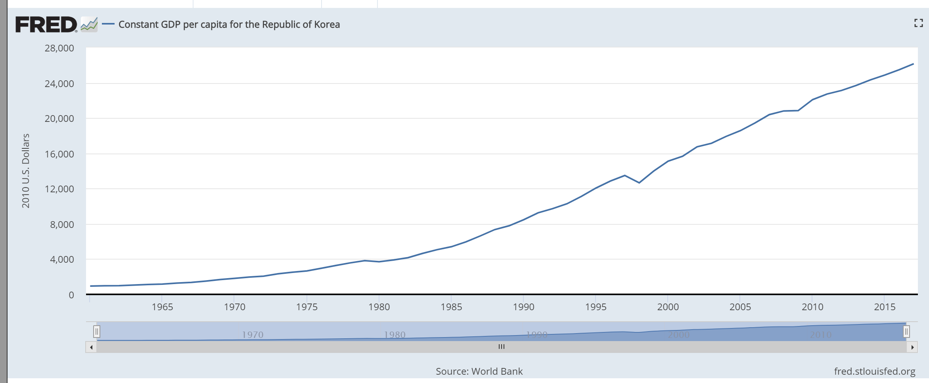
South Korea: the bright peninsula
Between 1960 and 2015 real gross domestic product per capita increased by a remarkable 2640 percent from $945 per person to $25,900, in 2010 USD!

Slide 13
South Korea from the 1980s to today
During the early 1980s, strategic steps away from the chaebol. Moved back from heavy investment in military production.
1
High technology industries takeoff. Samsung and Hyundai become global brand names.
2
Real gross domestic product per capita increased by a remarkable 248 percent from $530 to $18,500 in 2011 USD!
3
And then…
4
Asian financial crisis of 1997-98
International Monetary Fund (IMF) provides $57B bailout in exchange for more plans to decentralize.
Result more growth and development with the “creative economy” stepping forward
5

Slide 14
North Korea: the dark peninsula
Central planners simply “assume” they have the knowledge, expertise, and skills to know what works and what does not when, where, and at what price.
Turn to the trials and tribulations of South Korea to investigate the difficulties this type of system presents. South Korea’s adoption of command and control system was not continuous. It moves away from it. With each step, more and more people are lifted out of poverty and open to higher standards of living.
No property rights, limited investment in human capital, technology is imported, limited investment in human capital across the masses, closed economy to international trade with restricted trade with China

Slide 15
North Korea: the dark peninsula
Income in North Korea is one-thirtieth (1/30th) of that of South Korean,
Average height is about 5 inches shorter,
Weight is 15 pounds lighter in the North than in the South;
Life expectancy at birth is ten years less in the North than in the South;
26.2 percent of North Korean infants die at birth compared to less than 3 percent of infants in South Korea;
South Korean annual global exports and imports total well over one trillion (U.S dollars), while North Korean global exports and import totals are about 8.7 billion (U.S. dollars).

Slide 16
Institutions matter.
What explains the differences among nations in long-term economic growth in North Korea and South Korea when they have a shared history and culture?
Economic systems!
South Korea increasingly values life, liberty, and the individual’s personal choice of how to pursue happiness. By contrast, North Korea spends tremendous amount of resources restricting individual rights and freedoms.

Slide 17
Tawni.org/presentations
Foreign Policy Research Institute
EconEdLink.org
Register
Search “Economic Systems”
Video and Quiz
Virtual Economics 4.5 flash drive
1400 lesson plans across grade levels and subjects and searchable by topics
57th Annual Financial Literacy & Economic Education Conference (Oct 05-06, 2018 in Atlanta)
Reach out to a university-based center, state council, or another affiliate
Tawni.org

