Slide 1
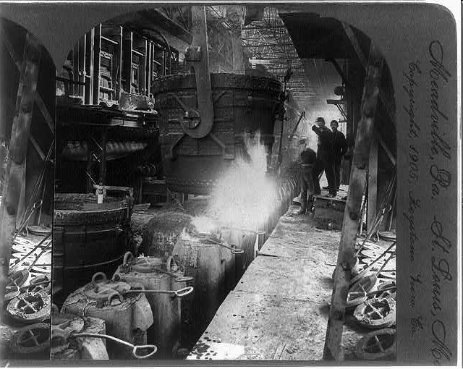
The Rise of Big Business and the Demise of the Trusts

Slide 2
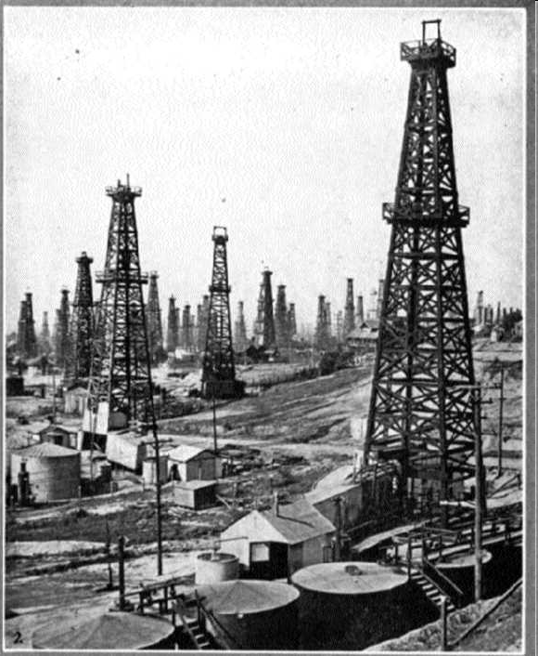
Overview
The rise of the industrial United States.
Were the Robber Barons Robbers or Barons?
The fall of the trusts - - where did all the trusts go?

Slide 3
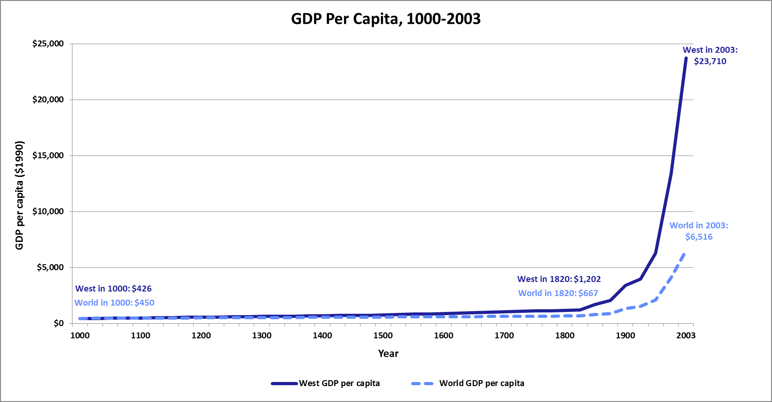
Per Capita Income: The Last 1000 Years
Income stagnated for the 800 years following year 1000, but growth has exploded during the last 200 years.
(Measured in 1990 dollars) world per capita income was $667 in 1820 – only about 50% higher than year 1000. By 2003, however, income had risen to $6,516 – 10 times the level of 1820.
During the past 200 years, the income growth of the high-income industrial countries (West) has grown even more – nearly 20 fold.

Slide 4
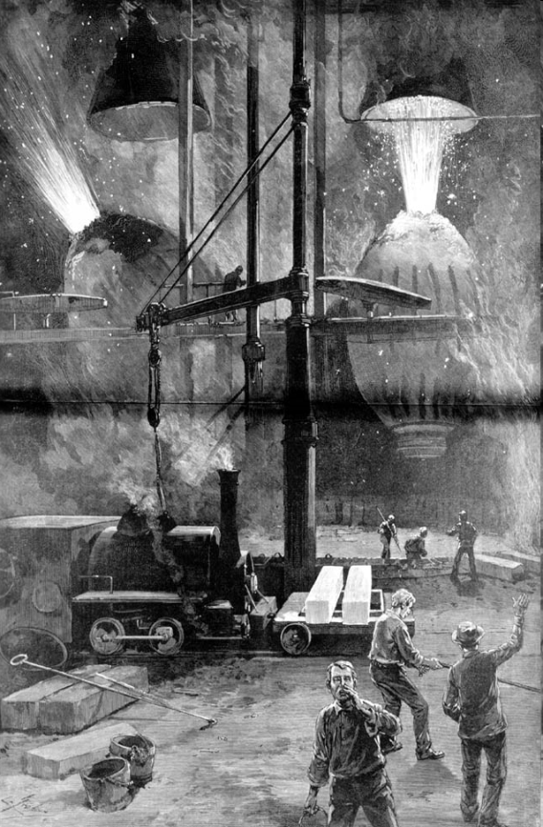
The Industrial Development of the United States

Slide 5
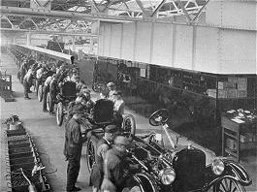
Business Gets Big
The United States economy changed dramatically in the period following the Civil War.
  The average standard of living more than doubled between 1870 and 1910.
  Business itself changed during this time.
  Various ways were tried to increase the size of businesses, including corporations and trusts.
Why were big businesses able to produce many kinds of goods and services more cheaply than small businesses?

Slide 6
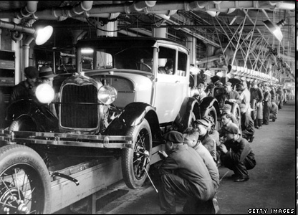
Characteristics of Mass Production
Large number of units produced
Low cost per unit
Large amount of capital (plants and machines)
Coordinated work force (organized often in an assembly-line fashion)
Division of labor

Slide 7
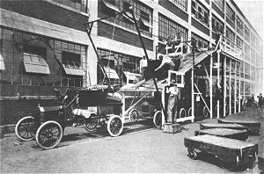
Economies of Scale
In manufacturing, the ability to reduce the average cost for each unit of production was achieved by spreading costs out over many units and over a long period of time.

Slide 8
Fixed Costs, Variable Costs and Their Relationship to Cost per Unit
1. Fixed costs are costs that do not change when the number of units produced increases or decreases. For most business firms, fixed costs include the following:
  Capital
  Utilities
  Property taxes
2. Variable costs are costs that change when the number of units produced increases or decreases. For many business firms, variable costs include the following:
  Labor
  Raw materials
3. Total fixed costs + total variable costs = total cost.
4. Total cost divided by the number of units produced = cost per unit.

Slide 9
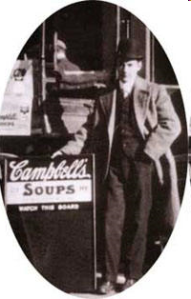
Figuring the Costs: The Tomato Plant
Weekly output =
Total fixed cost =
Variable cost per unit =
Total variable cost =
Total cost =
Cost per unit =
100 cans of tomato soup
$10,000 a week
$.25 per can x 100 cans =
$ 25
$10,025
$10,025
100 cans $100.20
What price will you need to charge?
Will you sell any?
Who benefits?

Slide 10
Figuring the Costs: The Tomato Plant
Weekly output =
Total fixed cost =
Variable cost per unit =
Total variable cost =
Total cost =
Cost per unit =
1,000 cans of tomato soup
$10,000 a week
$.25 per can x 1,000 cans =
$ 250
$10,250
$10,250
1,000 cans $10.25
What price will you need to charge?
Will you sell any?
Who benefits?

Slide 11
Figuring the Costs: The Tomato Plant
Weekly output =
Total fixed cost =
Variable cost per unit =
Total variable cost =
Total cost =
Cost per unit =
30,000 cans of tomato soup
$10,000 a week
$.25 per can x 30,000 cans =
$ 7,500
$17,500
$17,500
30,000 cans $.58
What price will you need to charge?
Will you sell any?
Who benefits?

Slide 12
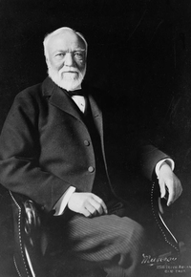
Andrew Carnegie and the American Steel Industry
Andrew Carnegie took advantage of this sort of mass production.
His motto: “Watch costs and the profits take care of themselves.”
  Large number of units produced
  Low cost per unit
  Large amount of capital
  Coordinated work force
  Division of labor

Slide 13
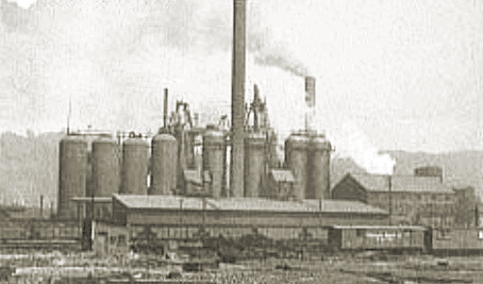
Lucy Furnaces
Carnegie developed the Lucy Furnace which would become the supplier of pig iron for his Union Mills.
The Lucy furnace set world records for producing 642 tons of pig iron per week.
The average had been 350 tons per week.
This provided Carnegie with a springboard to become the nation’s leading steel maker.
Lucy Furnaces
Pittsburgh, PA, 1872

Slide 14
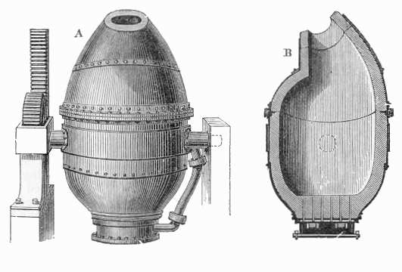
Andrew Carnegie and the American Steel Industry
Carnegie eagerly embraced new technologies.
His mills surged ahead of Great Britain in steel production.
When his mills became obsolete, he engaged in “creative destruction.”
He leveled them to build new state-of-the art mills.
This drove his competitors crazy.
The Bessemer furnace burned away the high carbon content of pig iron.

Slide 15
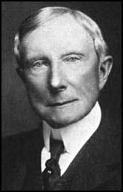
John D. Rockefeller and the Oil Industry
When oil first oozed out of the ground in western Pennsylvania, it was regarded as a nuisance.
But by the 1880s, kerosene was used for lighting.
It replaced whale and coal oil as consumers’ indoor lighting fuel of choice.

Slide 16

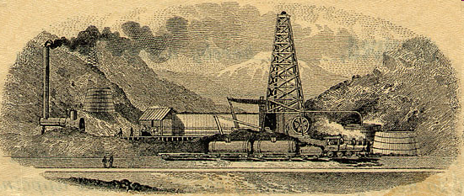
John D. Rockefeller and the Oil Industry
John D. Rockefeller consolidated the oil industry.
He substituted tanker cars for barrels and later added pipelines.
He cut transportation costs with “sweetheart deals” with railroads.
He made Standard Oil into the dominant oil producer in the world.

Slide 17
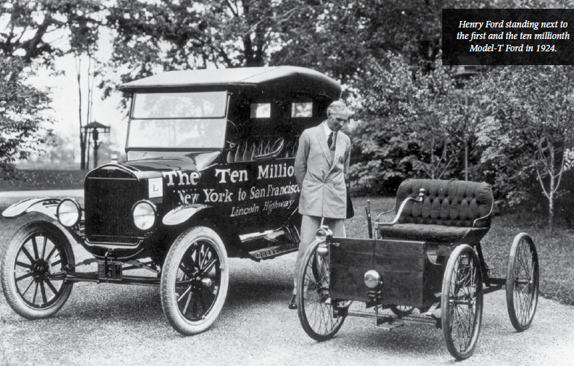
Henry Ford and the Automobile Industry
Henry Ford launched the manufacture of the modern automobile.
He combined using interchangeable parts and mass production to develop an assembly line for making cars.
This allowed more cars to be produced in less time and at lower costs.
Ford’s “break-out” year was 1908–1909 with the launch of the Model T.
Detroit became the “Motor City” because of Henry Ford.

Slide 18
The Magic Marker Mark Factory
Round | Wage $5.00 | Number of Marks Produced | Average Cost Per Mark
1
2
3

Slide 19
Productivity
Productivity measures the amount of output (finished goods and services) produced relative to the inputs (productive resources) used.
Productivity Output Input
Labor productivity is relatively easy input to measure since we can measure wages and hours.
Productivity Output
Labor Hour

Slide 20
Farm Productivity Trends
Hours per Crop
Year | Wheat | Corn | Cotton
1840 | 233 | 276 | 439
1880 | 152 | 180 | 304
1900 | 108 | 147 | 283
1910-14 | 106 | 135 | 276
Table 24.2 Stanley Lebergott, The Americans: An Economic Record, 1984

Slide 21
Productivity Gains in Percent
Decade | Total Economy
1889-1899 | 17%
1900-1909 | 12%
1910-1919 | 12%
Table 33.3 Stanley Lebergott, The Americans: An Economic Record, 1984

Slide 22
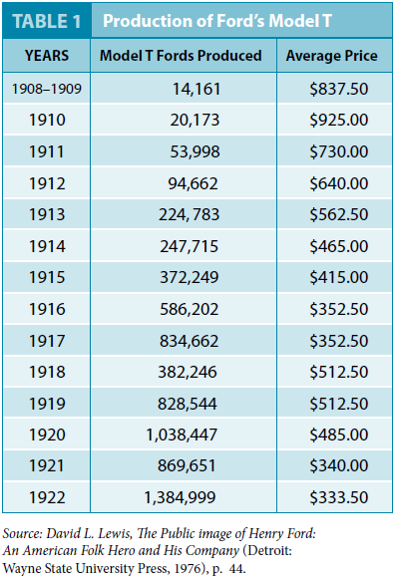
The Production of Ford’s Model T

Slide 23
Were the Robber Barons Robbers or Barons?

Slide 24
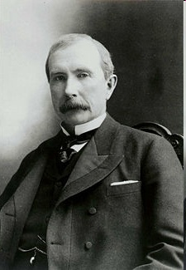
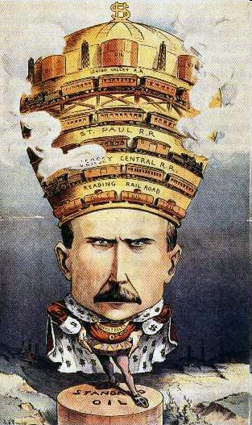
Industrial Entrepreneurs or Robber Barons?
Journalists often described the 19th-century industrialists as “Robber Barons.”
The term was meant to be derogatory.
What did it imply?
Were they born into noble families?
Did they steal from consumers?
Did they steal from workers?
Were these men in any legitimate sense robber barons?

Slide 25
Were the Robber Barons Born into Noble Families?
Young Andrew Carnegie was a penniless Scottish immigrant who began his work career as a bobbin boy in a textile factory.
Rockefeller was the son of a vagabond who sold questionable “elixirs” (magical or medicinal potions) door to door.
Rockefeller’s father was rarely around to care for his family.
Henry Ford was born on a farm in what is today Dearborn, Michigan.
His father was an immigrant from County Cork, Ireland, and his mother was the daughter of Belgian immigrants.

Slide 26
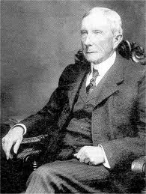
John D. Rockefeller Was Not Loved
Of Carnegie, Ford, and Rockefeller, Rockefeller was probably the most disliked.
He was regarded as brooding, cautious, and secretive.
When he died, a one author wrote: “Hell must be half full.”
Yet, he was a devout Baptist and lifelong tither.

Slide 27
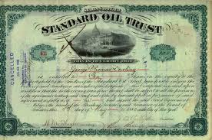
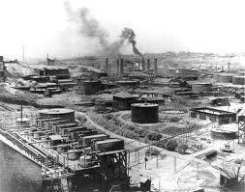
John D. Rockefeller Was Not Loved
Early on, Rockefeller attempted to fix oil prices by establishing a pool - - a “gentleman's agreement”- - among producers.
This brought outrage from the public.
Here is how it was to work according to Ida Tarbell…

Slide 28
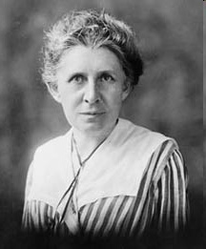
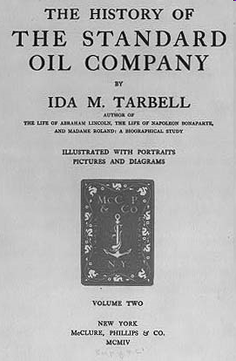
Did the Robber Barons Steal from Consumers?
“In the fall of 1871…certain Pennsylvania refiners…brought [to Mr. Rockefeller and his friends] a remarkable scheme…to bring together secretly a large enough body of refiners and shippers and to [force] all the railroads handling oil to give the company formed special rates [discounts] on it’s oil and [to charge higher rates to others.]”
Ida Tarbell quoted in The Progressive Movement 1900-1915 edited by Richard Hofstader, Englewood Cliffs, NJ 1963.

Slide 29
Did the Robber Barons Steal from Consumers?
“If they could get such rates it was clear that those outside the combination could not compete with them long, and that they would become eventually the only refiners. They could limit their output to actual demand and so keep prices up.”
Ida Tarbell quoted in The Progressive Movement 1900-1915 edited by Richard Hofstader, Englewood Cliffs, NJ 1963.

Slide 30
John D. Rockefeller: Friend of the Consumer
Why was Rockefeller successful?
Here is how it was to work according to John D. Rockefeller …

Slide 31
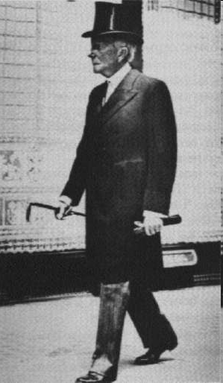
Did the Robber Barons Steal from Consumers?
“I ascribe the success of Standard Oil Company to its consistent policy of making the volume of its business large through the merit and cheapness of its products.”
“It has spared no expense in utilizing the best and most efficient methods of manufacture.”
John D. Rockefeller, Random Reminiscences of Man and Events Doubleday & Company, 1909.

Slide 32


The Logic of Monopoly Prices
John D. Rockefeller was accused of using a one, two punch to establish a monopoly in a particular region.
Punch 1: Reduce oil prices in order to force the local competition out of business.
Punch 2: Raise oil prices once control was achieved.

Slide 33
Punch 1
Rockefeller sold below the costs of his competitors - - his costs were lower.
He did not sell below his costs.
This drove his competitors crazy.
Many competitors decided to sell out to him.
Some went out of business.
Competitors were hurt but were consumers hurt?

Slide 34
Punch 2
So… What happened to the price for oil from 1860-1900?

Slide 35
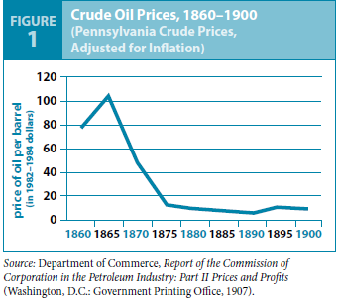
PA Crude Oil Prices History from 1860-1900 Adjusted for Inflation

Slide 36
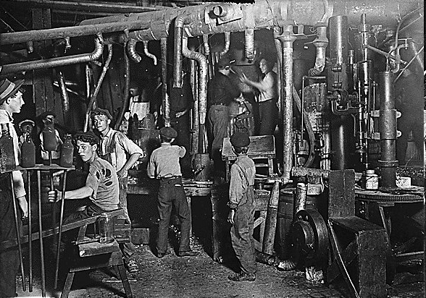
Did the Robber Barons “Steal” from Employees?

Slide 37
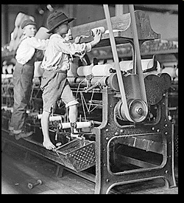
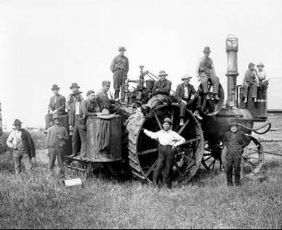
Life Was Rough for Workers
By today’s standards, life was rough in U.S. factories
  Intense competition for unskilled jobs
  Dangerous working conditions - - open furnaces, hot temperatures, dangerous chemicals, plenty of injuries.
  Long hours
  Child labor
But farming was no picnic either.
Farming had the highest injury rate of any industry - - people left when they saw a good chance.

Slide 38
Did Living Standards Decline?
Did standards of living actually decline for working families?

Slide 39
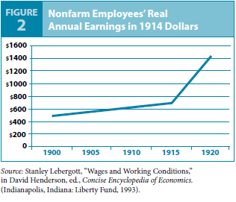
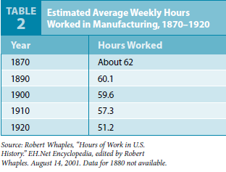
Real Annual Wages and Hours

Slide 40
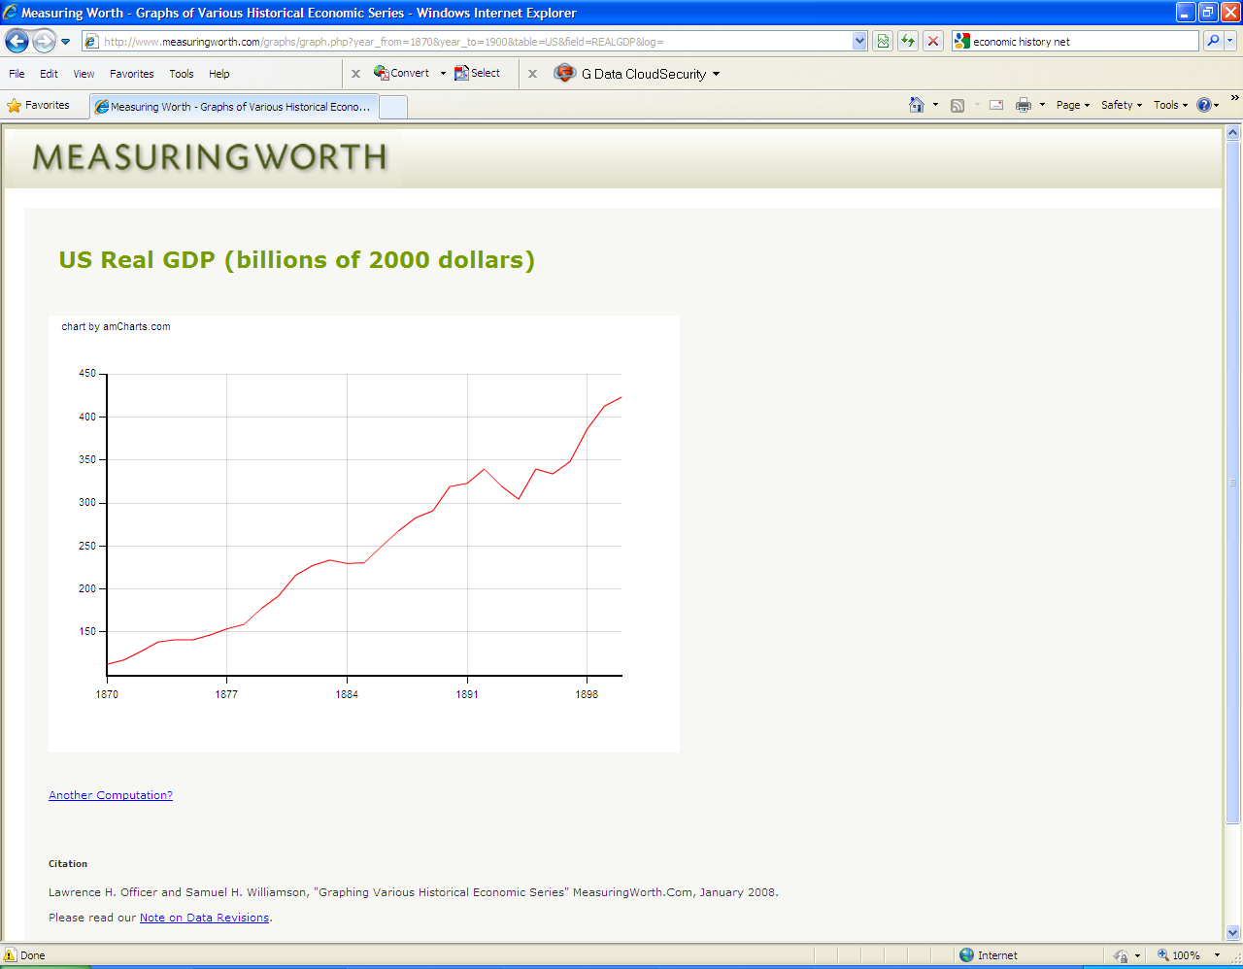

Slide 41
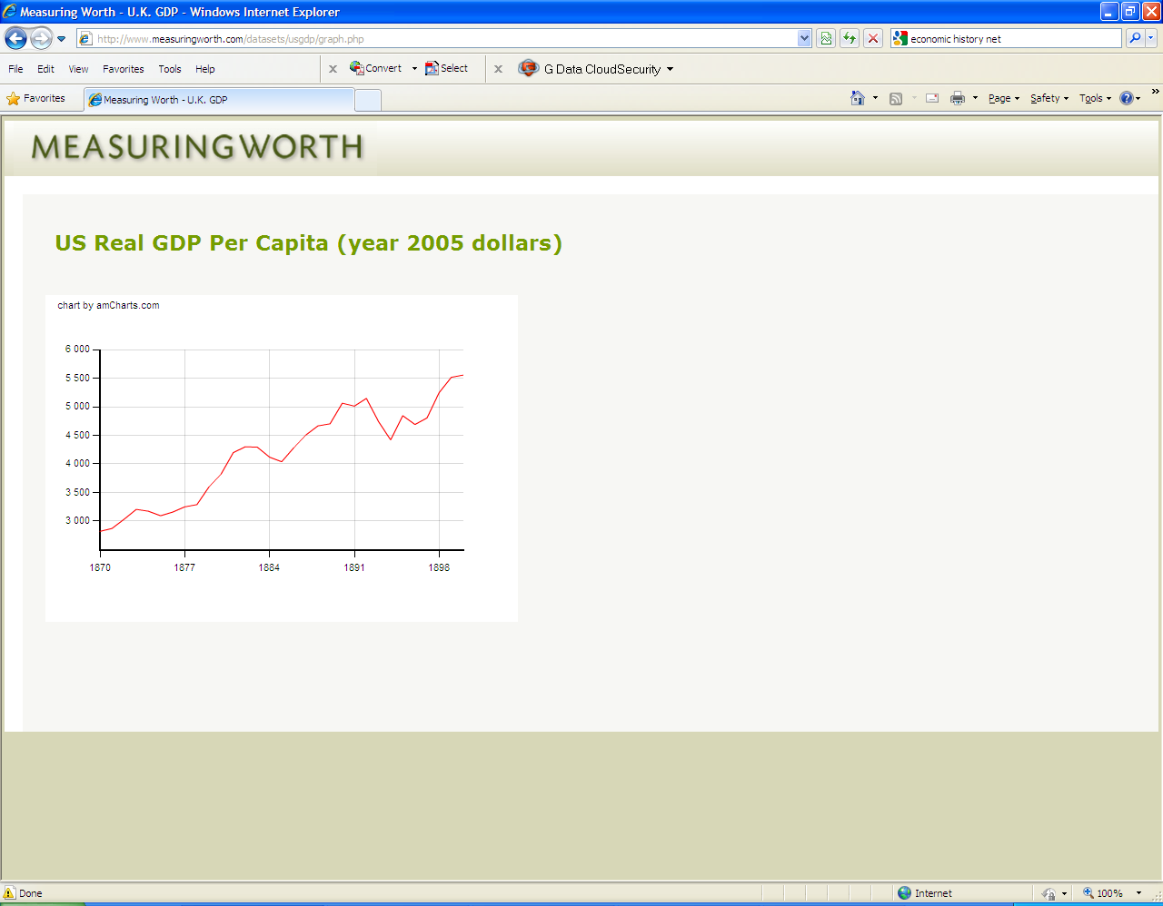

Slide 42
Life Expectancy in the United States
Approx. Date | Life Expectancy
 | White | Black
1850 | 39.5 | 23.0
1860 | 43.6 | n. a.
1870 | 45.2 | n. a.
1880 | 40.5 | n. a.
1890 | 46.8 | n. a.
1900 | 51.8 | 41.8
1910 | 54.6 | 46.8
1920 | 57.4 | 47.0
Table 18-2 Walton and Rockhoff, History of the American Economy, South-Western Thomson Learning 2002

Slide 43
Estimates of Unemployment During the 1890s
Year | Lebergott | Romer
1890 | 4.0% | 4.0%
1891 | 5.4 | 4.8
1892 | 3.0 | 3.7
1893 | 11.7 | 8.1
1894 | 18.4 | 12.3
1895 | 13.7 | 11.1
1896 | 14.5 | 12.0
1897 | 14.5 | 12.4
1898 | 12.4 | 11.6
1899 | 6.5 | 8.7
1900 | 5.0 | 5.0
Source: Romer, 1984

Slide 44
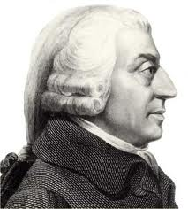
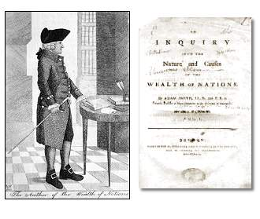
Invisible Hand?
Was the growth of big business in the late 19th century a case of Adam Smith’s invisible hand?
Allowing these industrialists to act in their own self-interest promoted positive social outcomes - - increased standards of living - - even though it was not their main intention.

Slide 45
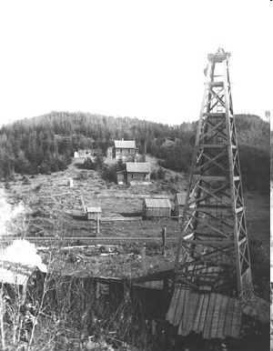
John D. Rockefeller: What Was His Greatest Contribution?
Rockefeller was praised for his philanthropy.
Was this his most important economic contribution?
A case could be made that providing cheap oil to consumers was his largest contribution.
He probably saved the whales from extinction.

Slide 46
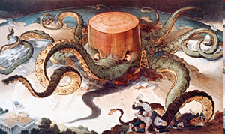
The Fall of the Trusts

Slide 47
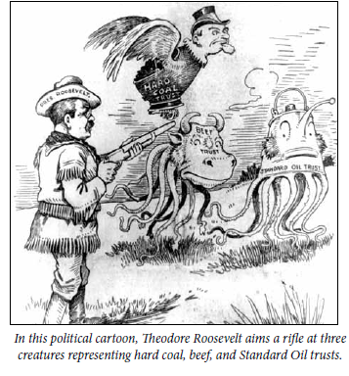
Where Did the Trusts Go?
The late nineteenth century was a time when business leaders used a variety of tactics to establish monopolies in many key industries.
Large trusts emerged in petroleum, cottonseed oil, whiskey, steel, sugar refining and tobacco.
TR was elected as a “trust buster.”
His administration filed 44 anti-trust law suits, but broke up only two.
What happened to all the others?
Where did all the monopolies go?

Slide 48
Here’s a Hint
I Love Lucy hamburgers

Slide 49
Big Businesses Seek to Form Monopolies
A monopoly is the power to dominate an industry.
A pure monopoly is an industry with one supplier, selling a unique product, in a market that is difficult to enter due to high start up costs or government rules.
Vertical Integration: Acquire all the resources along the chain of production: Andrew Carnegie.
Horizontal Integration: Consolidation lead by mergers: John D. Rockefeller.
New Forms of Business Organization: Corporations and later trusts.
But…where did the trusts go?

Slide 50

A Monopoly: Bet You Can’t Keep One
Scene 1: Ms. Jane Morgan has a $100 bill which she says she will give to any class member for the highest individual bid.
Scene 2: Ms. Morgan leaves the room. Scott jumps to his feet and proposes that the class agree on one bid - - a penny for the $100 bill Let’s use the money for a class party. Heads nod. Everyone seems to agree.

Slide 51
A Monopoly: Bet You Can’t Keep One
Scene 3: Ms. Morgan returns. She explains that each student may now submit a bid on a piece of paper. All bids will remain anonymous and completely confidential. The $100 bill will be given to the highest bidder after school, in secret.
Scene 4: Ms. Morgan collects the bids.
An assumption of economic thinking is that people respond to incentives in predictable ways.
What do you think will happen?

Slide 52
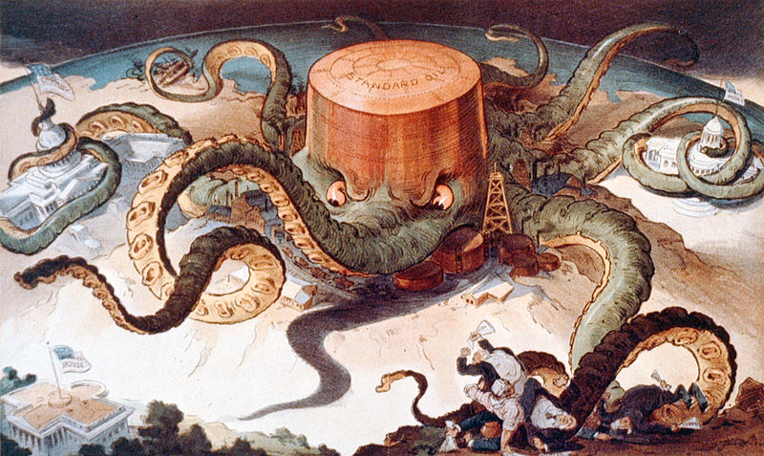
Treaty of Titusville in 1872
Rockefeller tried to get all the producers of oil in the area to stop drilling for an agreed upon period of time.
If they all stopped, they believed, they could force the price of oil to rise.
Prices did begin to rise.
But, producers in Clarion County, Pennsylvania, just kept on drilling.
They were despised by the other producers. But they broke the trust, and prices of oil began to fall.

Slide 53
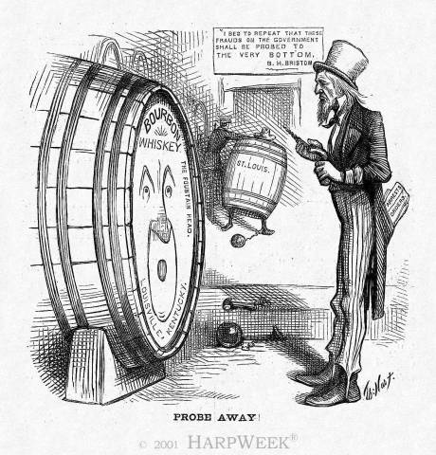
The Whiskey Trust
The Whiskey Trust dominated the whiskey market from 1887 to 1895.
As the trust gained control over its market during those years, it raised its prices.
But higher prices acted as incentives, attracting new producers to the market.
The new producers “cheated” by undercutting the price established by the trust, and the trust fell apart in 1895.

Slide 54
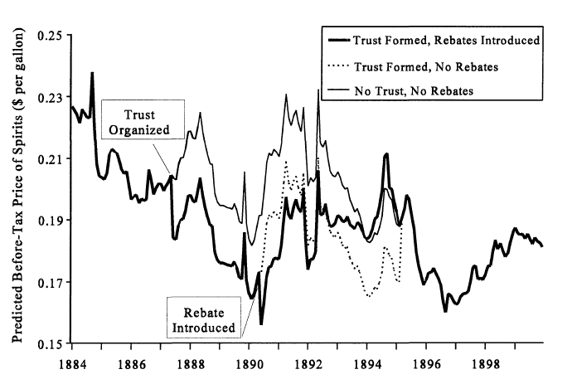
Werner Troesken, The Whiskey Trust, 1890-1895
Journal of Economic History, 1998

Slide 55
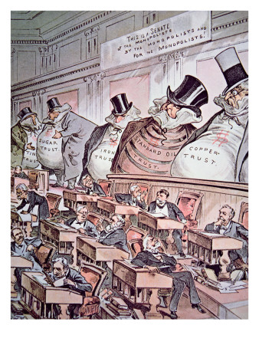
The Sugar Trust
Sugar refining was “a comedy of errors” according to economic historian Gerald Gunderson.
When members of the trust raised their prices, competitors appeared almost overnight.
Farmers from the West began growing sugar beets.
Farmers in Louisiana began producing sugar cane.
Importers began purchasing sugar cane from other nations.
Sugar prices fell.

Slide 56
Standard Oil
Standard Oil dominated the market but even it faced competition.
No law prevented new firms from entering the oil industry.
Other business people noticed that Standard Oil was earning impressive profits.
They imitated Standard oil’s methods and jumped into the market.
J. M. Guffey Petroleum Company (later known as Gulf Oil) began operations in 1901.
The Texas Company (later known as Texaco) was formed in 1902.
In 1907 the Royal Dutch Shell Group was created.

Slide 57

A Newer View of Competition
Today, we understand that it is not essential to have many sellers to assure competition.
A better indicator is the ease with which additional competitors can enter the industry.
Is there any law or regulation preventing entry?
Gerald Gunderson “An Entrepreneurial History of the United States” Beard Books, 2005.

Slide 58

Questions

Slide 59
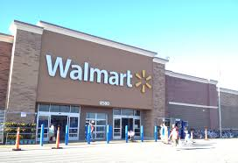
Where Did the Monopolies Go? Implications for Today

Slide 60
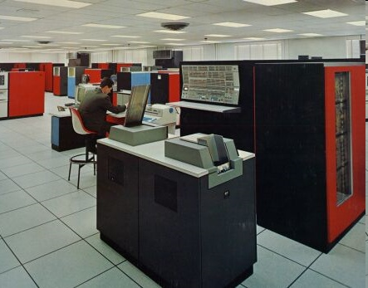
The IBM Case
The failure to understand “contested” markets has led to serious efforts to break up American corporations.
The U.S. Justice Department accused IBM of being a monopoly.
It was accused of preempting competition by controlling a large share of the market.

Slide 61
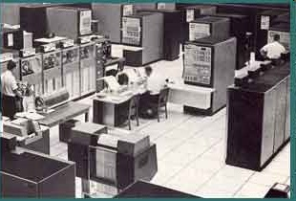
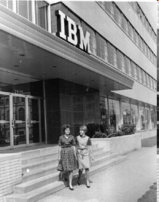
The U.S Department of Justice Relents
For over 10 years - - 1969 – 1982, after thousands of court hours and millions of dollars in legal fees, the case was dropped.
You don’t promote competition by attacking competitors.
Lesson? Perhaps it is better to go after barriers to entry.

Slide 62
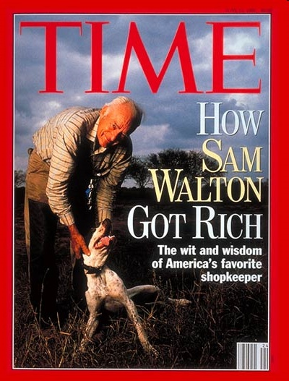
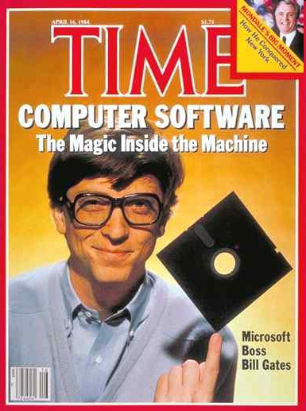



Current Cases?
IBM was the industry leader.
What about Micro-soft?
What about Walmart?
What about Google?
What about the merger of United Airlines and American Airlines?

Slide 63
Questions

Slide 64
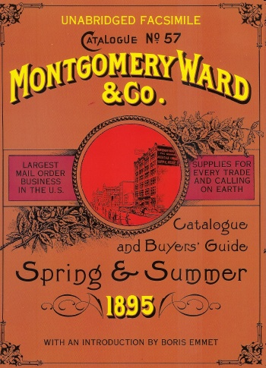
Not All Monopolies Are Big: Competition in Unexpected Places
Much of America in the late 19th century was characterized by small regional monopolies.
The arrival of mail order houses added new competition:
  Montgomery Ward, 1872
  Sears & Roebuck, 1886

Slide 65
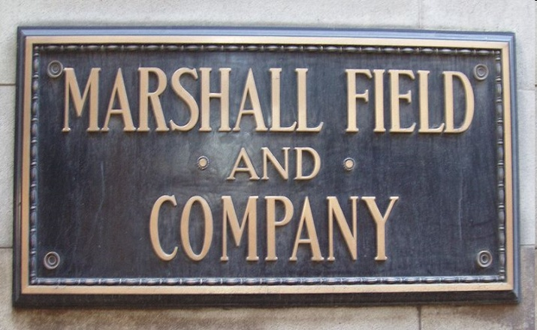
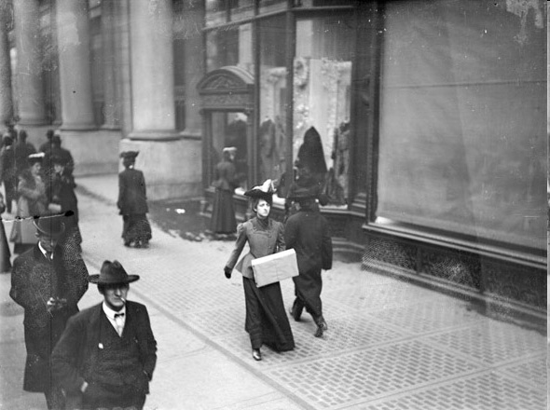
Competition in Unexpected Places
The arrival of department stores:
  Marshall Field and Company, 1852, later Macy’s
  Hudson’s beginning in Detroit in 1861
  Wanamaker’s in Philadelphia, 1902

Slide 66
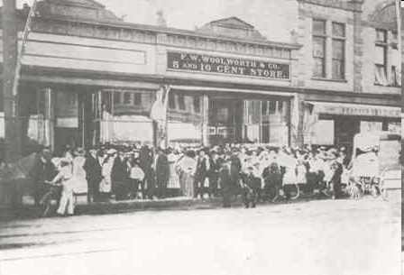


Competition in Unexpected Places
The arrival of chain stores:
  F.W. Woolworth Company, 1879
  J.C. Penny, 1892

Slide 67
Per Capita Income: The last 1000 years
Income stagnated for the 800 years following year 1000, but growth has exploded during the last 200 years.
(Measured in 1990 dollars) world per capita income was $667 in 1820 – only about 50% higher than year 1000. By 2003, however, income had risen to $6,516 – 10 times the level of 1820.
During the past 200 years, the income growth of the high-income industrial countries (West) has grown even more – nearly 20 fold.
$25,000
GDP Per Capita
2003: $23,710
$20,000
West GDP per capita
$15,000
2003: $6,516
$10,000
World GDP per capita
1820: $1,202
$5,000
1820: $667
1000
1100
1200
1300
1400
1500
1600
1700
1800
1900
2003

Slide 68

Crude Oil Price History from 1861-2006, dollars per barrel

