Slide 1
"Why Do Some Nations Prosper: North and South Korea"
LUCIEN ELLINGTON, The University of Tennessee at Chattanooga
TAWNI HUNT FERRARINI, Northern Michigan University
[2.E.3]
The Latest and Greatest in Economic Education
Monday, 1:10 - 2:25 pm

Slide 2
Institutions matter.
What explains the differences among nations in long-term economic growth in North Korea and South Korea when they have a shared history and culture?
Economic systems!
North Korea relies on a command and control system while South Korea increasingly leans on a free market system.

Slide 3
Institutions matter.
What explains the differences among nations in long-term economic growth in North Korea and South Korea when they have a shared history and culture?
Economic systems!
North Korea relies on a command and control system while South Korea increasingly advances toward a free market system.

Slide 4
The institutional story
Shared beginnings and separation
Different institutional trajectories
Hermit Kingdom
Japanese occupation
One peninsula: two Koreas
Park ended the experiment with democracy
Land reform (started with US assistance and under Rhee)
Education (started with US assistance and under Rhee)
Investment in physical and human capital continues
Export-led growth (managed through chaebol)

Slide 5
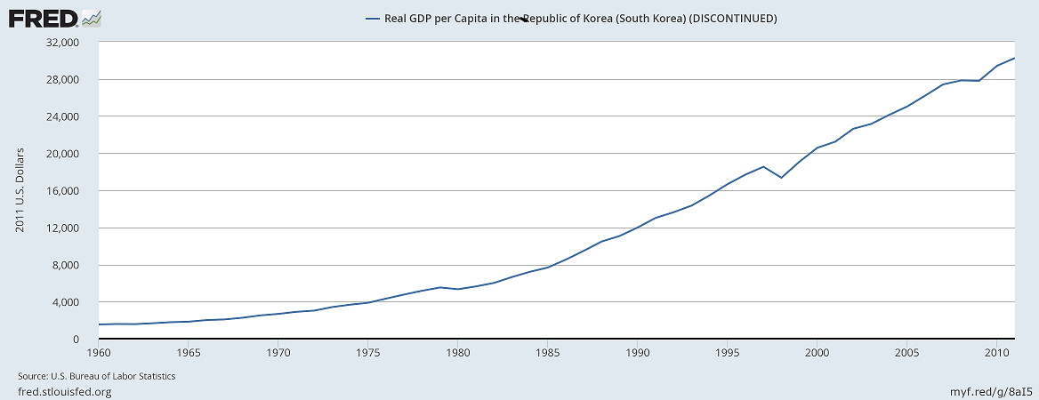
South Korea: the bright peninsula
Between 1980 and 1997, real gross domestic product per capita increased by a remarkable 248 percent from $5300 to $18,500 in 2011 USD!

Slide 6
South Korea from the 1980s to today
During the early 1980s, strategic steps away from the chaebol. Moved back from heavy investment in military production.
High technology industries takeoff. Samsung and Hyundai become global brand names.
Real gross domestic product per capita increased by a remarkable 248 percent from $530 to $18,500 in 2011 USD!
And then…
Asian financial crisis of 1997-98
International Monetary Fund (IMF) provides $57B bailout in exchange for more plans to decentralize.
Result more growth and development with the “creative economy” stepping forward

Slide 7
North Korea: the dark peninsula
Central planners simply “assume” they have the knowledge, expertise, and skills to know what works and what does not when, where, and at what price.
Turn to the trials and tribulations of South Korea to investigate the difficulties this type of system presents. South Korea’s adoption of command and control system was not continuous. It moves away from it. With each step, more and more people are lifted out of poverty and open to higher standards of living.
No property rights, limited investment in human capital, technology is imported, limited investment in human capital across the masses, closed economy to international trade with restricted trade with China

Slide 8
North Korea: the dark peninsula
Income in North Korea is one-thirtieth (1/30th) of that of South Korean,
Average height is about 5 inches shorter,
Weight is 15 pounds lighter in the North than in the South;
Life expectancy at birth is ten years less in the North than in the South;
26.2 percent of North Korean infants die at birth compared to less than 3 percent of infants in South Korea;
South Korean annual global exports and imports total well over one trillion (U.S dollars), while North Korean global exports and import totals are about 8.7 billion (U.S. dollars).

Slide 9
Institutions matter.
What explains the differences among nations in long-term economic growth in North Korea and South Korea when they have a shared history and culture?
Economic systems!
South Korea increasingly values life, liberty, and the individual’s personal choice of how to pursue happiness. By contrast, North Korea spends tremendous amount of resources restricting individual rights and freedoms.

Slide 10
Tawni.org/presentations
Foreign Policy Research Institute, submitting manuscript for publication consideration
Tuesday, 10:25 - 11:40 am, [3.C.3], Redesigning Economics Education, "Meeting Millennials in Their Preferred Learning Spaces“ using Quality Matters Rubrics
Tuesday, 3:50 - 5:05 pm, [3.G.2], Plagues, Zombies, the Apocalypse and Economics: An Economist’s Guide to Surviving the End of the World, "That’s Mine! - Property Rights among the Walking Dead“
Wednesday, 10:25 - 11:40 am, [4.C.10], Free Market Economics and the Media (Chair)

