Slide 1
Tawni Hunt Ferrarini, PhD in economics Sam M. Cohodas Professor Northern Michigan University
Tawni.org
Tawni.Ferrarini@gmail.com

Slide 2
Common Sense Economics: What everyone should know about wealth and prosperity.
12 key elements of economics
Elements explain why some nations (states, regions, and districts) prosper
Economics of government
Personal finance

Slide 3
Helping others understand the differences between government and markets

Slide 4
Common Sense Economics Way of Engaging Multimedia Learners
Read from the Common Sense Economics book
Watch LearnLiberty.org’s “Economics: How Big is the U.S. Debt?” with A. Davies and other videos
Listen to “CSE 3.4 Politics and Foreign Trade by Dwight Lee (audio 7:46)and other podcasts
Do

Slide 5
You now have $75!

Slide 6
Cart 1
Cart 2

Slide 7
How can we choose between cart 1 and cart 2?
Tradition
Contest
Drawing
Equal share
Command and control
Voting
Individuals in a market economy with secure property rights

Slide 8
Voting by a simple majority
Based on the highest positive value (+) or lowest negative value (-), let’s have a show of hands for Cart 1.
Now, Cart 2.
The winner is????????
CART 2!!!!

Slide 9
Anyone have two carts, both with negative values?
Voting for the lesser of two evils

Slide 10
Responsible and accountable individual and decision-making
Personal value > price, purchase or pass.
Personal value < price, pass.

Slide 11
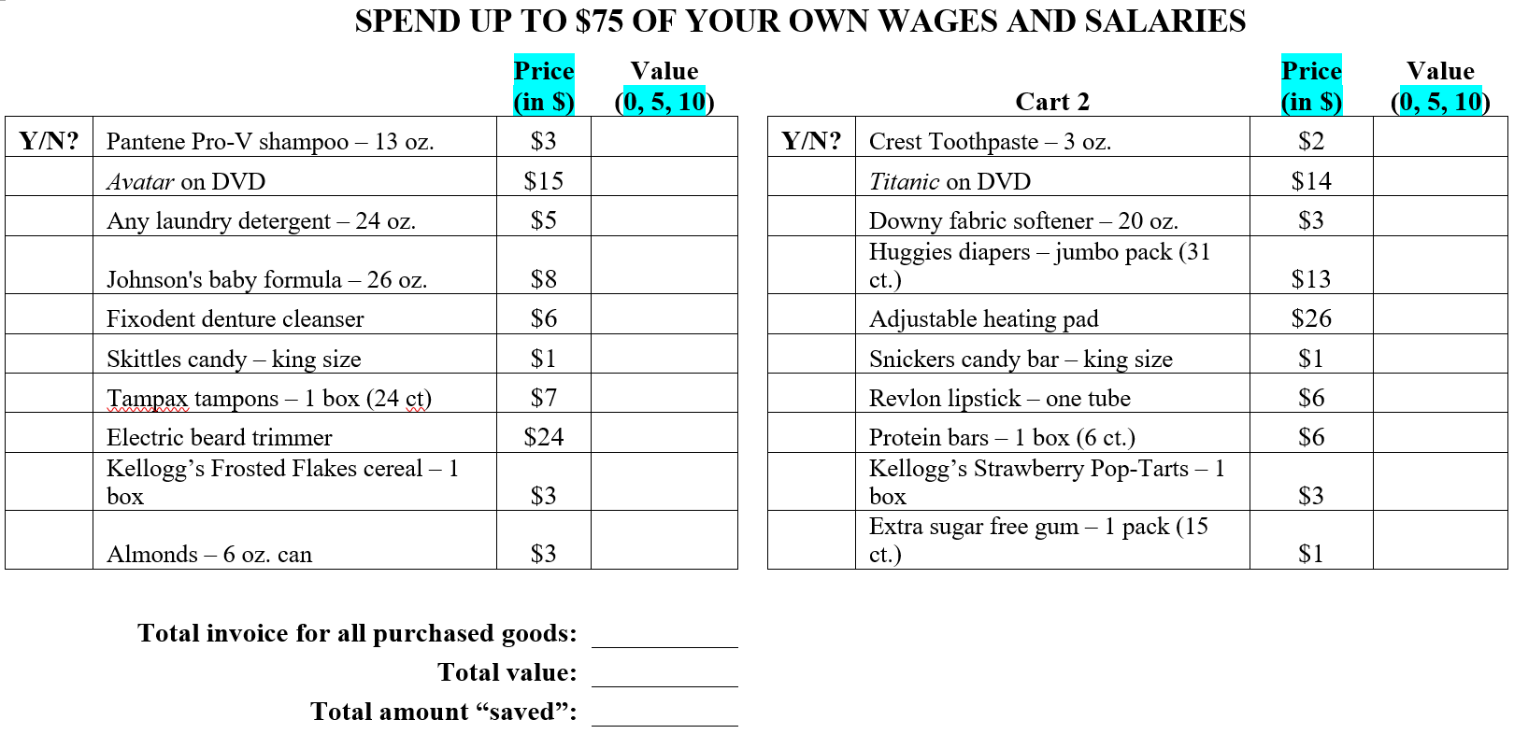
Common Sense Economics in Action

Slide 12
When individuals spend their earned income, they are:
More purposeful in spending;
More likely to save (and invest);
Actively participants in growing their economics and helping others prosper.

Slide 13
Your life’s journey
Government sponsored program
Personal path influenced by personal income and choices
Health, wealth, and happiness

Slide 14
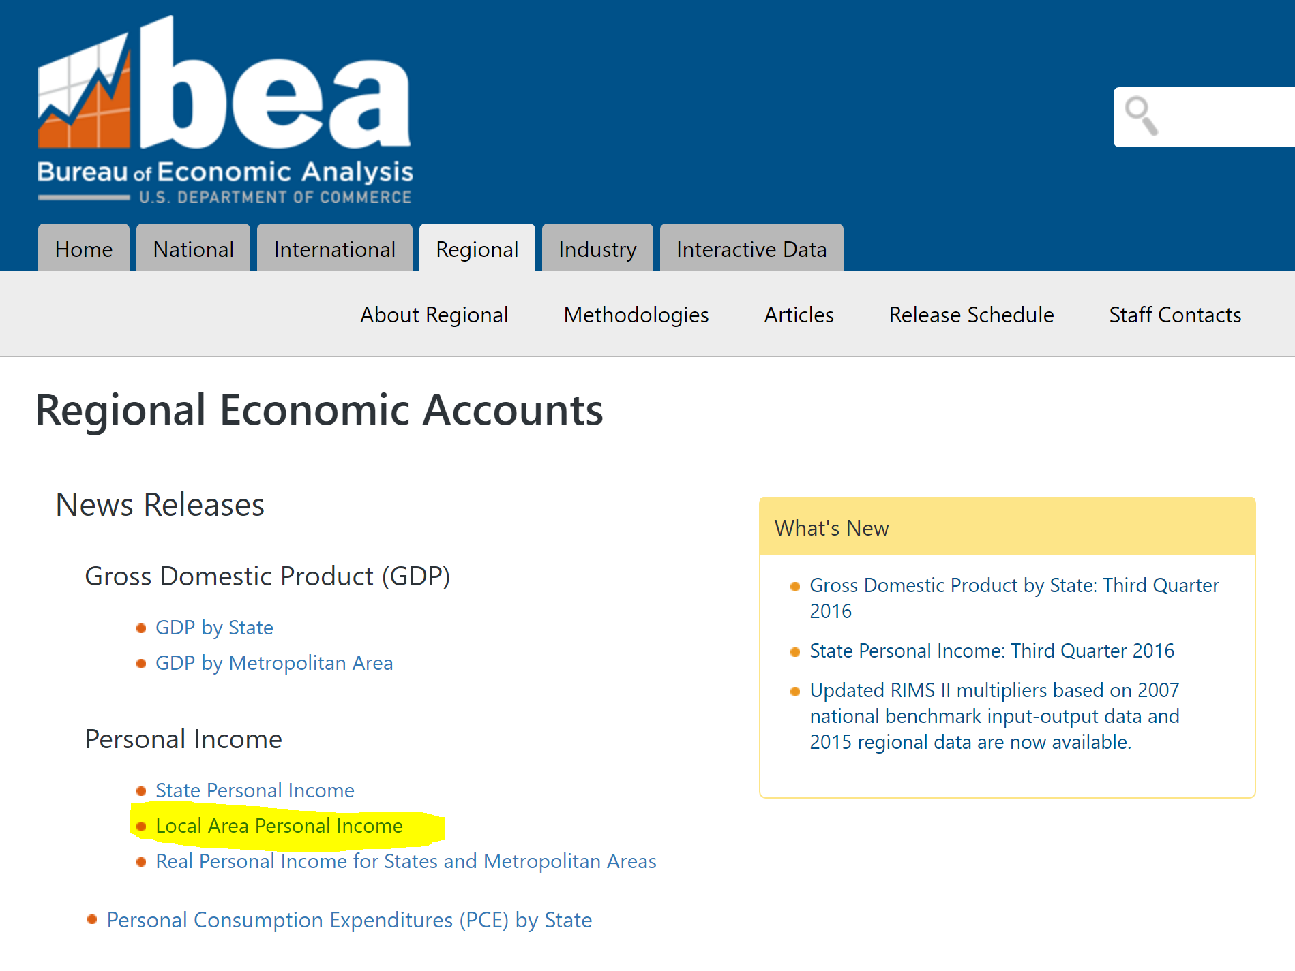
Search “BEA local area personal income”

Slide 15
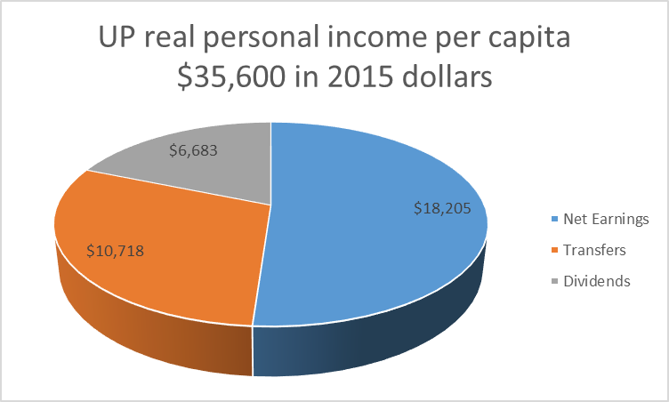
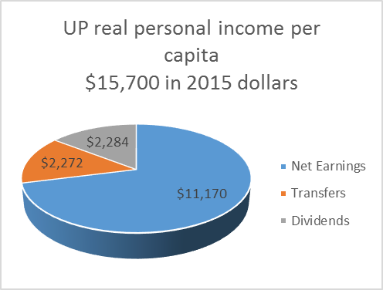
UP personal income more than doubles
1970: $15,700 in 2015 dollars (BEA)
2015: $35,600 in 2015 dollars (BEA) (127%↑)

Slide 16
Personal income breakdown into 3 categories, BEA
Active income (wages and salaries)
Transfers (public assistance funded by taxpayers in borrowed dollars)
Dividend, interest, and rent

Slide 17
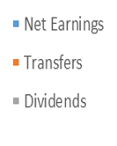
Drilling down signals change in composition: Active income slips
1970: 71% wages and salaries
2015: 51% wages and salaries

Slide 18
Drilling down signals change in composition: Public assistance grows
1970: 14% government programs
2015: 31% government programs

Slide 19
Drilling down signals change in composition: Dividend, interest, and rent nudge up
1970: 15% dividend/rental income
2015: 19%
dividend/rental income

Slide 20
Similar trends in the State of Michigan
State of Michigan | 1970 $20,500 | 2015 $43,000
Labor | 79% | Drops to 61% (↓)
Transfers | 09% | Rises to 22% (↑)
Dividend and rental income | 13% (rounding) | Rises to 17% (↑)

Slide 21
Similar trends in the United States
United States | 1970 $20,600 | 2015 $48,000
Labor | 76% | 64% ↓
Transfers | 09% | 17% ↑
Dividend and rental income | 15% | 19% ↑

Slide 23
Realities
The act of providing public assistance increases the likelihood that individuals will turn to it. As a safety net, it serves a positive purpose in an economy and across time.
As a hammock, government-sponsored programs pose challenges to the region.
Businesses adjust plans to meet the needs of the growing population of people receiving funds through government programs.
Some businesses, workers, entrepreneurs, and investors exit the region in pursuit of higher profit and income margins in markets that are not as dependent on government programs.
Individuals living on public assistance for extended periods have difficulty maintaining an employment advantage, their savings and investments are limited, and their benefits take funds from other uses.
Demand for public assistance outstrips the supply of government programs.

Slide 24
Transformation of the individual
The best economic revitalization program involves education.
Education helps individuals take steps toward moving into high paying, high skilled jobs that transform the region’s resources into goods and services valued by others in their communities, throughout your state, throughout the United States, and around the globe.

Slide 25
Stay in touch! Tawni Hunt Ferrarini Tawni.Ferrarini@gmail.com Tawni.org Canvas.net “Common Sense Economics”

